Slide 1
E-Commerce Sales Forecast
(Laura Fink)

Slide 2
Preparation:
Data: sales data of an UK online retailer
Aim: help the retailer by predicting daily amounts of sold products
Import: 541909 entries and 8 variables

Slide 3
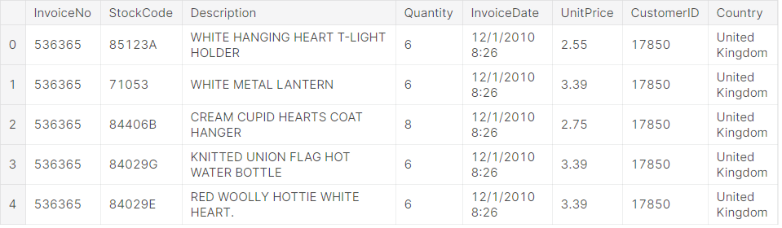
Get familiar with the data:
Attributes: InvoiceNo, StockCode, Description, Quantity, InvoiceDate, UnitPrice, CustomerID, Country.

Slide 4
Get familiar with the data:
One customer with ID xxxxx of the United Kingdom made a single order that has the InvoiceNo xxxxxx. The customer ordered several products with different StockCodes, Descriptions, UnitPrices and Quantities. Moreover, the InvoiceDate is the same for these products.

Slide 5
Explore the data
How many % of missing values do we have for each feature?
Almost 25% of the customers are unknown and we also have 0.2% of missing descriptions.
It was noticed that there were 1454 missing customers and also 1454 unit prices missing. In cases of missing Descriptions we always miss the customer and unit price as well.

Slide 6
Explore the data
The missing Customer IDs are bad too because price and quantities of entries without a customer ID can show extreme outliers.
As we want to make some predictions later on these inconsistencies can be very disruptive. An advice for the retailer is to setup strategies for transactions that are somehow special or faulty.
Dropped all the occurrences.

Slide 7
Explore the data
The Time period: 2010-12-01 08:26:00 <-> 2011-12-09 12:50:00
The different Invoice numbers: 22186
Cancelled transactions (data description starts with a “c”): 2.2% of all entries
All cancellations have negative Quantities but positive, non-zero UnitPrices.
Given the data we are not easily able to understand why a customer made a return and it’s very difficult to predict such cases as there could be several, hidden reasons why a cancellation was done. Thus, we decided to drop them.

Slide 8
Explore the data
Number of StockCodes: 3663
We can see some occurrences here as StockCode consists of 5 numeric chars, but the length can vary between 1 and 12 and also there are StockCodes with no numeric chars at all. We will also drop these dates.

Slide 9
Explore the data
Number of unique descriptions: 2983
Some descriptions correspond to a similar product type. We often have a color information about the product as well. And the most common descriptions seem to confirm that the retailer sells various different kinds of products. All descriptions have uppercase chars.
Going deeper into details by counting the length and the number of lowercase chars we discovered that almost all descriptions don’t have lowercase chars, but there are also exceptional cases.

Slide 10
Explore the data
Unique number of StockCodes: 2781
Unique number of Descriptions: 2981
We have more Descriptions than StockCodes because we still have StockCodes with multiple Descriptions.

Slide 11
Explore the data
Number of Customers: 4315
Number of Countries delivered by the retailer: 37 (unique)
It is noticed that the retailer sells almost all the products in UK, followed by many European countries.

Slide 12
Explore the data
We dropped some rows because we found that they had the UnitPrice equal to zero which is not normal.
We decided to keep in analysis just the transactions with prices between 0.13 (exp(-2)) and 20.08 (exp(3)) as we don’t want to make predictions for rare products with high prices.

Slide 13
Explore the data
Moving on to the Quantities Analysis we saw that most products are sold in quantities from 1 to 12, but there are again some unrealistic outliers and with the help of log-transformed distribution it would make sense to make a cut at 54.59 (exp (4)). In this case we would still cover more than 95% of the data.

Slide 14
Focus on daily product sales
We computed a daily aggregation of this data by extracting temporal features out of the InvoiceDate. We also computed the Revenue gained by a transaction using the UnitPrice and the Quantity. (Revenue = Quantity * UnitPrice)

Slide 15
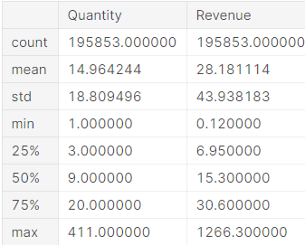
Focus on daily product sales
How are the quantities and revenues distributed?
As can be seen by the min and max values the target variables shows extreme outliers. Thus, we will exclude them as they will mislead our validation.
Use only target ranges data that are occupied by 90%
of the data entries. Just be aware of the fact that we have
lost some information given by the % we have excluded.

Slide 16
Focus on daily product sales
Number of lost entries: 5258
Looking at the remaining distributions of daily quantities we can see that the distributions are right skewed. (lower values are more common)
Daily sales quantities seem to be multimodal: a daily sale of 1 is common as well as quantity of 12 and 24. We can say that quantities are often divisible by 2 or 3.
Specific products are often bought as single quantities or in a small bunch.

Slide 17
Prediction of daily product sales
Usage of catboost as predictive model.
The prediction of daily Quantities and Revenues are both regression tasks and we will use the catboost regressor.
For the loss and metric function we chose RMSE (Root Mean Square Error) and it computes the error between the target value and the predicted value, takes the square to make sure both positive and negative deviations contribute to the sum in the same way. Then, the mean is taken by dividing with the total amount of entries in the data and finally to obtain the error for single predictions the root is taken.

Slide 18
Prediction of daily product sales
Validation strategy: our data covers only one year, thus we have a high increase of sold products during pre-Christmas period. We will start with validation data that covers at least 8 weeks and after generating new features by exploring the data we used time series validation that should help us to understand if the model is able to solve the prediction task during both: pre-Christmas period and non-Christmas period.

Slide 19
Prediction of daily product sales
In order to easily generate new models and compare the results we created some classes:
1) Hyperparameter Class: holds all important hyperparameters we have set before training (the loss function, the evaluation metric, the max depth of trees)
2) Catmodel Class: it trains the model and can show learning process as well as feature importances and some figures for result analysis
3) Hyperparameter-Search Class: it uses Bayesian Optimization and Gaussian Process Regression to find optimal hyperparameters. The computation of the score for one catfamily model may be expensive, but the Bayesian Optimization can be a plus.

Slide 20
Prediction of daily product sales
Time series validation Catfamily: this model holds information about how to split the data into validation chunks and it organizes the training wit sliding window validation.
Baseline model & result analysis: with no feature engineering and no hyperparameter search, the model loss has converged. The RMSE has a high value but as we said it is influenced by outliers and we should look at the distribution of individual absolute errors.

Slide 21
Prediction of daily product sales
We can see that the distribution of absolute errors of single predictions is right skewed.
The median single error is half of the RMSE score and significantly lower.
By ploting the target vs prediction we can see that we got higher errors for validation entries that have high true quantity values above 30. To improve this, we need to make better predictions for products with true high quantities during validation time.

Slide 22
Prediction of daily product sales
If we take a look at the weekday feature we will see that low values (0 to 3) correspond to Monday, Tuesday, Wednesday and Thursday. These are days with high amount of product sales and they push towards higher sharp values and consequently to higher predicted quantity values. Higher weekday values are for Friday, Saturday and Sunday and they push towards negative sharp values and to lower predicted values.
The StockCode and the Description are very complex features. As we have seen we have close to 4000 different StockCodes and even more Descriptions, we should try to engineer features that are able to describe the products in a more general way.

Slide 23
Prediction of daily product sales
Bayesian Hyperparameter Search with GPyOpt: we can obtain a better score after hyperparameter search.
Feature engineering
Baseline for product types

Slide 24
Prediction of daily product sales
Temporal patterns:
Thursday is the day on which most products are sold
Friday and Sunday have very low transactions
On Saturday there are no transactions at all
The pre-Christmas period starts in september and shows a peak in November
February and April are months with the lowest sales

Slide 25
Bibliography
https://www.kaggle.com/allunia/e-commerce-sales-forecast

